Slide 1
Music Recommandation Engine
Irpan Yierpan, Keifer Convertino

Slide 2
Project Overview
We want to provide a tool that will improve the way people interact with and discover music.
We want to use models to help listeners find new music that is similar to their previous interests.
Additionally, we want to help aspiring musicians reach a larger audience with their music.
Data and machine learning can help predict the popularity of an artist’s new song, and provide an auditory analysis of their song in comparison to popular music.

Slide 3
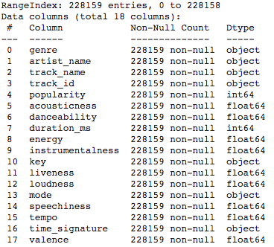
Dataset Overiew
Dataset of songs in spotify
Each track is identified by a track id
Can be used with Spotify API
228159 Tracks x 18 Variables
No missing data
Link: https://www.kaggle.com/huanntran100/spotify-song-popularity-prediction/data

Slide 4
Features
Numeric Audio Features
acousticness
danceability
energy
instrumentalness
liveness
loudness
speechiness
tempo
valence
Other Numeric Features
popularity
duration_ms
Categorical Audio Features
mode
key
time_signature
Other Categorical Features
genre
track_id
track_name
artist_name

Slide 5
Preprocessing
Combined duplicated tracks over the years by avaraging popularity over time
Only kept songs with duration_ms within 3 Standard Deviation (15sec - 9min47sec)
Dropped tracks from the “Comedy” genre
Removed key and mode because they are not relevant audio features
Removed time_signature and instrumentalness because most songs has same value
Removed energy because it is highly corelated(+0.81) to loudness, and loudness is more corelated to popularity which is what we are interested in
Min-max scaled all the numerical features since they have upper & lower bound

Slide 6
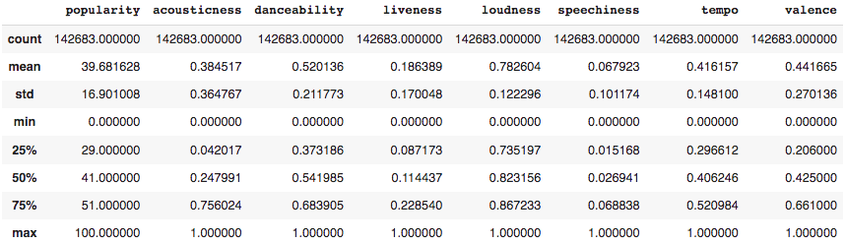
Final Dataset
142,683 Tracks
Categorical Features
track_id, artist_name, track_name, genre(26 in total)
Numerical Features

Slide 7
Category Generation
Create customized categories for users, in addition to the genre categories, using machine learning.
Clustering: K-Means vs. GMM
K-Means classifies each songs to one and only one cluster
GMM gives a probability of the songs being in each cluster
A song can belong in multiple categories, thus, GMM is better

Slide 8
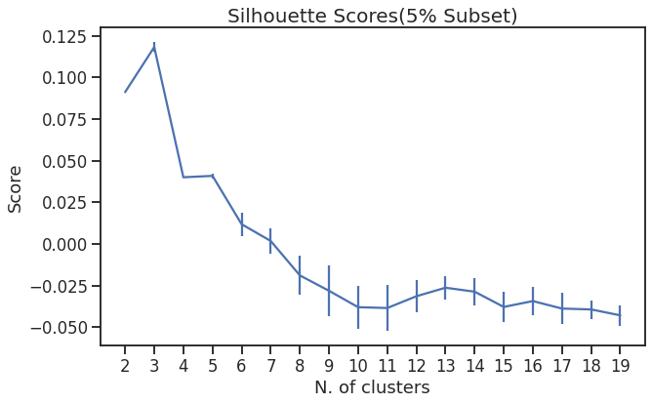
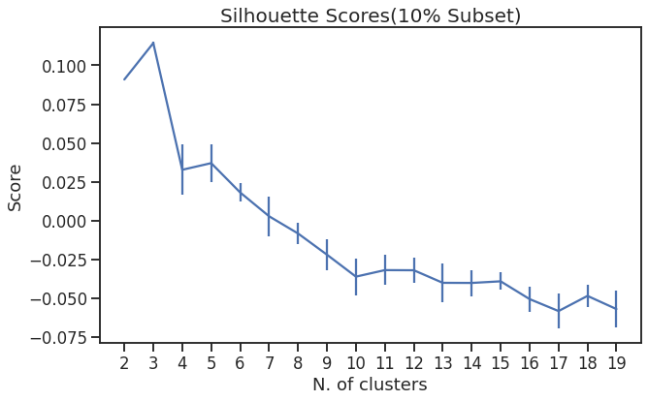
GMM: Optimal Number of Clusters
Goal: Maximize Silhouette Score
Using subsets because whole data will take days to run, but can see 5% and 10% subsets have very consistent trends
3 is the max, but we want more categories, so we choose 5 (the second max)

Slide 9
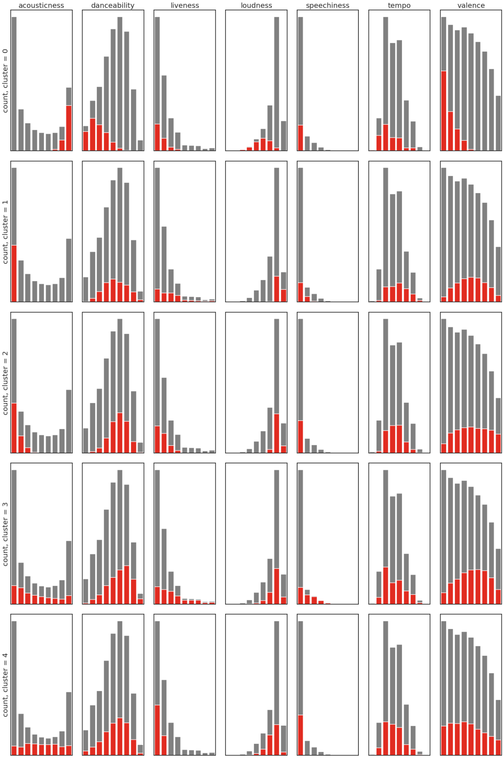
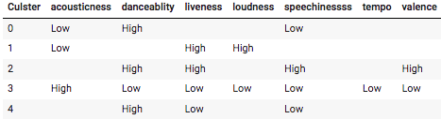
Labeling Clusters
Cluster 0: Chill
Cluster 1: Loud
Cluster 2: Happy
Cluster 3: Acoustic
Cluster 4: Dance

Slide 10
Listener Recommendation
We want to provide a tool for listeners to receive recommendations for songs similar to the music they like.
We don’t have access to a user’s listening history or likes.
We can only rely on the songs that a user specifically designates as an input for our model.

Slide 11
k-Nearest Neighbors
kNN was a natural choice for this set of constraints.
We can ask a user to input a song that they like, extract the audio features from that track, and find the closest matches in our 100,000+ track dataset.
Additionally, we can use our previously computed clusters to further granulate these recommendations.
ex: I want “happy” songs that are similar to a song that I like.

Slide 12
Artist - Popularity
The Spotify Popularity Index: 0 to 100.
High popularity means higher chance for the music to be recommended to listeners and successed on the market.
Spotify uses their user traffic data to generate popularity score and update them regularly.
We are trying to predict based on the songs’ audio features.

Slide 13
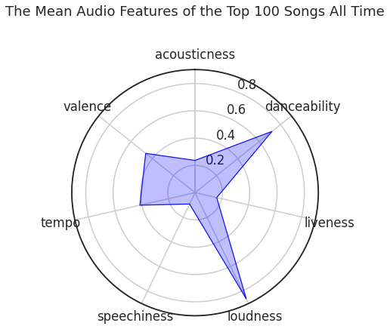
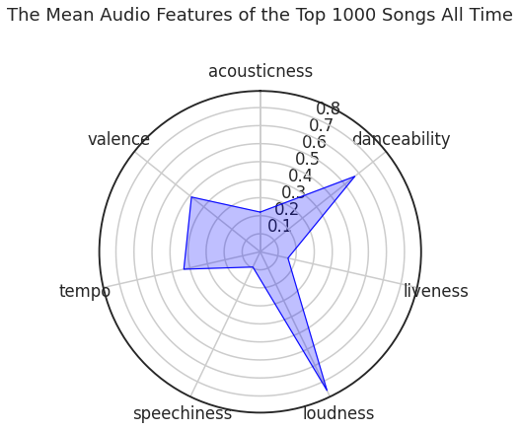
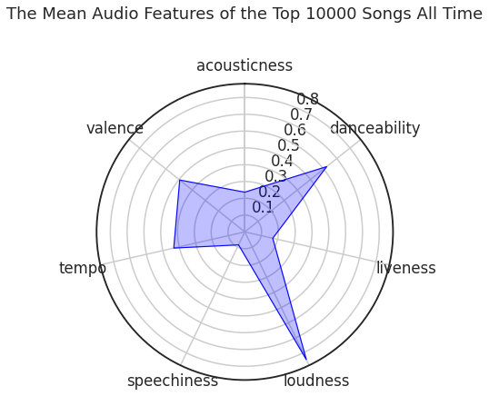
Popularity Analysis
High danceablity & Loudness
Medium Valence & Tempo
Low Acousticness & Liveness & Speechiness

Slide 14
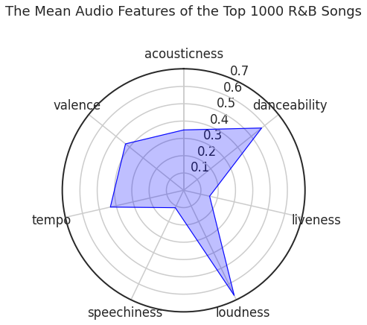
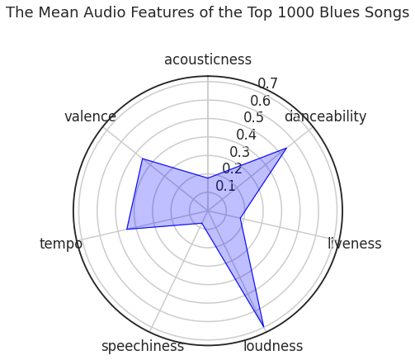
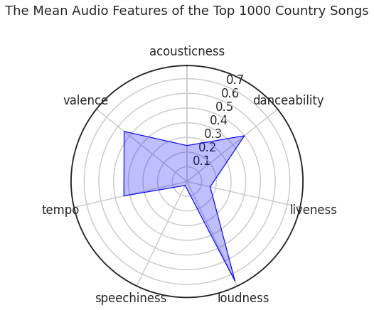
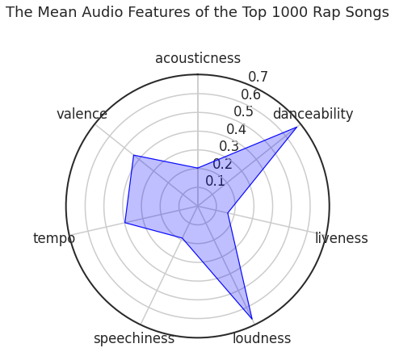
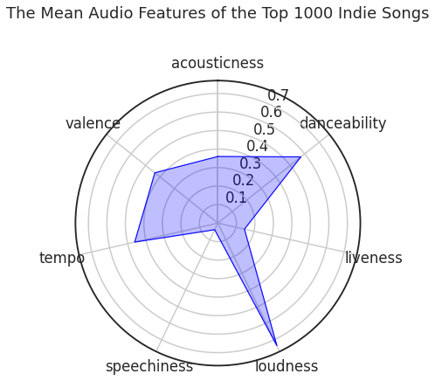
Popularity Analysis
Top popular songs of different genre have different mean audio features
Artists of different genres should focus on features differently to become popular

Slide 15
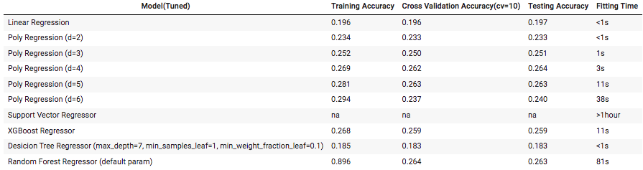
Popularity Prediction
Model selection Requirments:
High cross validation and testing accuracy (R^2 Scores)
Reasonalbly high training accuracy
Reasonable run time

Slide 16
Web Demo
http://dsci303-music-recommender.herokuapp.com/

Slide 17
Future Improvements
More data
Allow users to enter playlists/artists
And recommend playlists/artists as well
Incorporate user history/likes
Identify audio features that are particularly important for a listener?
No spotify API dependency on artists side
Neural networks on popularity predictions

Slide 18
Thank You!

